Slide 1
Dealing with the Coronavirus in Your Landscape or Lawn Care Business
Wednesday, March 18

Slide 2
PANEL OF EXPERTS
Whitney Brown, Esq. - HR & Legal Advisor, Lehr, Middlebrooks, Vreeland & Thompson, P.C.
Sam Steel, Ed.D. - NALP Safety Advisor
Drew Garcia, RMSS - Rancho Mesa Insurance Services - NALP Safety Chair and Insurance Expert
Andrew Bray, Esq. - NALP VP of Government Relations
Paul Fraynd - CEO, Partner of Sun Valley Landscaping

Slide 3
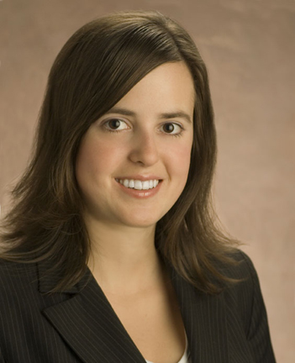
Whitney Brown, Esq.
NALP HR & Legal Advisor
Lehr, Middlebrooks, Vreeland & Thompson, P.C.

Slide 4
HR & LEGAL Q & A
As a Matter of Current Federal Employment Law, Must Employers Permit Employees to Work From Home As A Result of COVID-19 Diagnosis?
Short Answer: No.
COVID-19 Diagnosis is Not a Disability Under the ADA
But, COVID-19 Diagnosis May Exacerbate a Disability, And Require Accommodation
Disability and Accommodation Process is Always Case by Case

Slide 5
HR & LEGAL Q & A
As A Matter of Current Federal Employment Law, What Should an Employer Consider Prior to Agreeing to Work From Home Arrangements?
Wage and Hour Concerns
- Non-Exempt
- Exempt
Clear Communications and Not Setting An Entitlement
Non-Discriminatory Application
Other Considerations

Slide 6
HR & LEGAL Q & A
As A Matter of Current Federal Employment Law, What Should an Employer Consider Prior to Agreeing to Work From Home Arrangements?
Model Text To Incorporate in Work From Home Arrangements:
“Due to the unusual circumstances in our community caused by COVID-19, we are [assigning/permitting] you to work remotely for a temporary period [at your request and/or on a trial basis]. We are [assigning/permitting] remote work at this time even though some of your job’s usual essential functions may not be able to be completed remotely.”

Slide 7
HR & LEGAL Q & A
As a Matter of Current Federal Employment Law, What Should an Employer Consider If Facing a Downturn?
Reduction of Hours/Work
- Non-Exempt
- Exempt
WARN Triggers
Non-Discriminatory Layoff Procedures
Communication

Slide 8
HR & LEGAL Q & A
What is Going on with the Families First Coronavirus Response Act?
Current Status Update
Key Provisions of Both
- Applies to employers with fewer than 500 employees
- Effective date of not later than 15 days after enactment
- Sunset of December 31, 2020

Slide 9
HR & LEGAL Q & A
What is Going on with the Families First Coronavirus Response Act?
Emergency Family and Medical Leave Expansion Act
Only for employees unable to work or telework due to need to care for child under 18 years old due to child care provider or school closure related to the COVID-19 health emergency.
Employees are eligible if they’ve been on payroll for 30 days; no hours worked requirement.
12 week entitlement.
First 10 days of leave are unpaid (but likely to be covered by Emergency Paid Sick Leave Act).
Subsequent days are 2/3 the employee’s regular rate of pay for the number of hours the employee would have normally been scheduled to work, up to a cap of $200 per day and $10,000 in the aggregate.
Secretary of Labor may issue regulations to exempt business of fewer than 50 employees if providing leave “would jeopardize the viability of the business as a going concern.”
Employers of fewer than 50 employees in a 75 mile radius cannot be subject to civil suit.

Slide 10
HR & LEGAL Q & A
What is Going on with the Families First Coronavirus Response Act?
Emergency Paid Sick Leave Act
Paid Sick Leave must be provided to employees unable to work due to:
federal, state, local quarantine or isolation order related to COVID-19
health care provider has told employee to self-quarantine related to COVID-19
employee has symptoms of COVID-19 and is seeking a medical diagnosis
employee is caring for an individual subject to a quarantine or isolation order or who has been told by a health care provider to self-quarantine
employee is caring for child under 18 years old due to child care provider or school closure related to the COVID-19 health emergency
employee experiencing substantially similar conditions as specified by Secretary of HHS, in consultation with Secretaries of Labor and Treasury.
Full time employees entitled to 80 hours of paid leave
Part time employees entitled to the number of hours they work, on average, over a two week period.
No carryover
Employer may not require an employee to use any existing paid time off (vacation, sick, etc.) policy in place of this one or prior to this one.

Slide 11
Questions?

Slide 12
Sam Steel, Ed.D.
NALP Safety Advisor

Slide 13
COVID-19 PROTECTIVE MEASURES
PI – Pharmaceutical Intervention
Unfortunately, there are no current pharmaceutical cures for COVID-19.
NPI - Non-Pharmaceutical Intervention - Employees
Stay home when not feeling well.
Wash hands more often than normal with warm water and hand soap.
Use hand sanitizer gels or wipes when and where available.
Wear clean, and properly stored “personal” protective equipment (PPE).

Slide 14
COVID-19 PROTECTIVE MEASURES
NPI - Non-Pharmaceutical Intervention – PPE for Employees
DO NOT
Share PPE such as nuisance masks or respirators
Use a nuisance mask that is dirty or contaminated
Use a respirator that has not been fit-tested to the wearer
Use a respirator that has been stored in a potentially dirty environment
Use a respirator that is not intended for the assigned work activity

Slide 15
COVID-19 PROTECTIVE MEASURES
NPI - Non-Pharmaceutical Intervention – PPE for Employees
DO
Clean respirators with warm water and dish detergent after each use
Discard nuisance masks that are dirty, damaged, or contaminated
Keep masks and respirators in sealed containers clearly indicating user
Use a respirator that is designed and engineered for your work activity
Wash hands and exposed skin before leaving work at the end of the day

Slide 16
COVID-19 PROTECTIVE MEASURES
NPI - Non-Pharmaceutical Intervention – Employers
DO
Prepare and communicate safe respiratory program policies and procedures
Designate a company contact responsible for respiratory programs
Provide an adequate inventory of respiratory protection devices
Provide hand soap, single-use towels, and sanitizers in work locations
Conduct and document frequent respiratory training for all staff
Develop and implement less risky crew transportation methods

Slide 17
COVID-19 PROTECTIVE MEASURES
NPI - Non-Pharmaceutical Intervention – Employers
WORKING WITH THE 6-FOOT SPACE AND SANITATION RECOMMENDATIONS
Limit occupants in “crew cab” vehicles
Keep hard surfaces in vehicles sanitized frequently
Suggest employee commuting to worksite as an option
Provide hand soap, single-use towels and sanitizers in work locations
Encourage frequent hand washing/sanitizing, especially before meals
Provide liquid refreshment often with single-use drinking vessels

Slide 18
Questions?

Slide 19
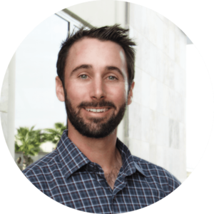
Drew Garcia, RMSS
Vice President, Landscape Group
Rancho Mesa Insurance Services, Inc.
NALP Safety & Risk Management Committee Chair

Slide 20
Questions?

Slide 21
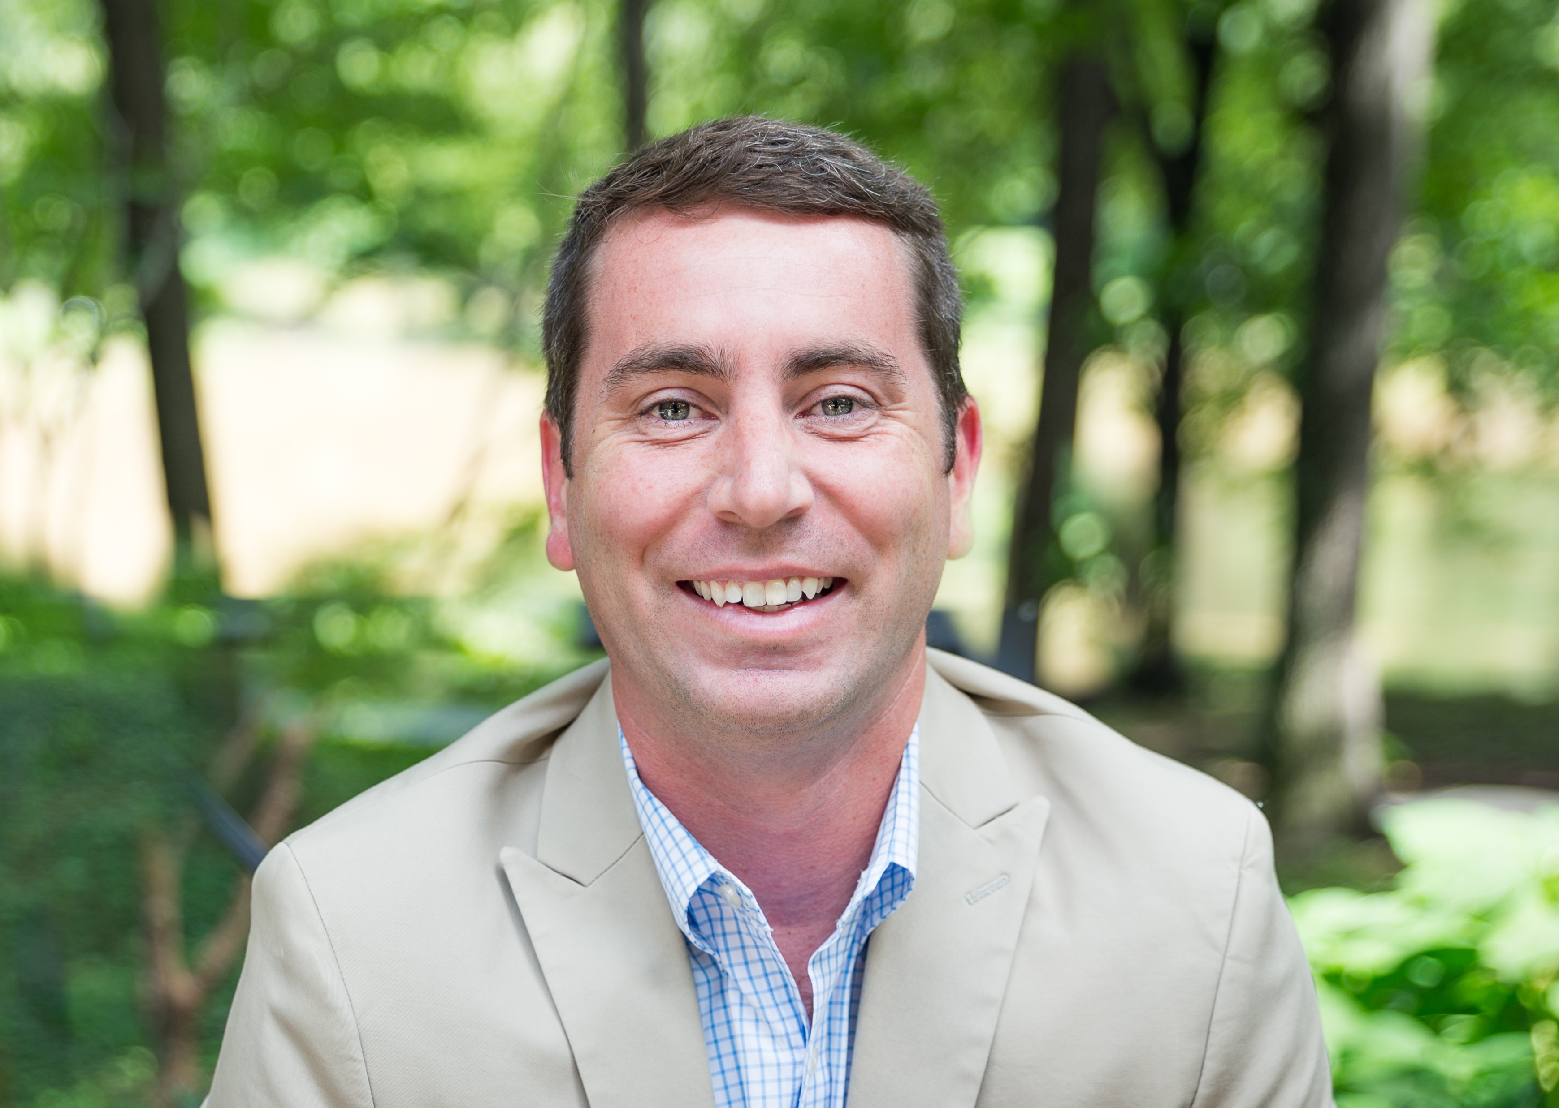
Andrew Bray Esq.
NALP VP of Government Affairs

Slide 22
GOVERNMENT AFFAIRS UPDATE
What to do if your state or locality orders a lockdown or shutdown
H2B Update

Slide 23
Questions?

Slide 24
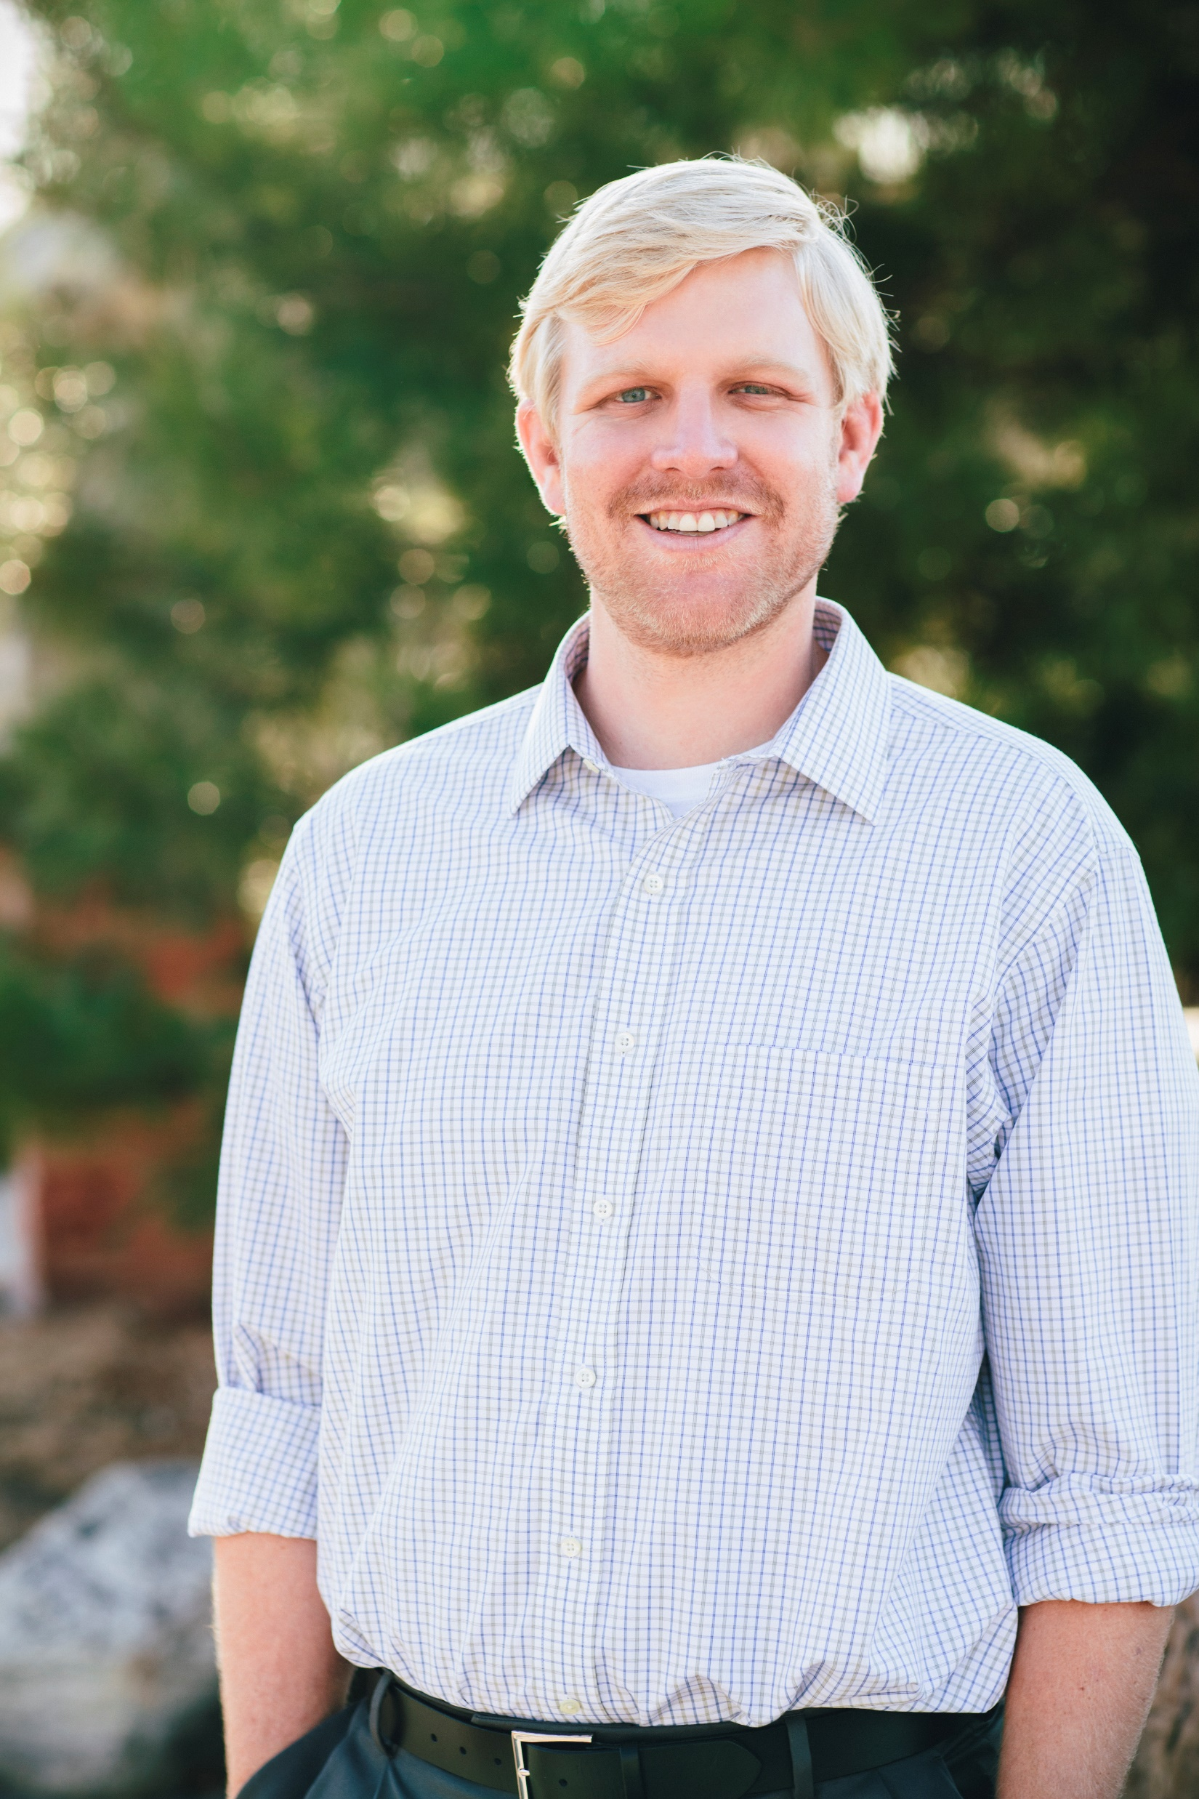
Paul Fraynd
CEO, Partner
Sun Valley Landscaping

Slide 25
SUN VALLEY LANDCAPING COMMUNICATION PLAN
Internal safety precautions we are implementing
Communication to clients
Expectations for sales and budget changes due to the rapidly changing situation
Adherence to government regulations and also the new bills coming out and how these may affect us
Some hope – in the power of our great industry and the power of the great outdoors
Our role as leaders in this

Slide 26
Questions?

Slide 27
RESOURCES
NALP Letter on Lockdown/Shutdown
NALP Coronavirus Web Page
Facebook Landscape and Lawn Care Coronavirus Discussion Group

Slide 28
CONTACT INFORMATION
Whitney Brown, Esq. - HR & Legal Advisor, Lehr, Middlebrooks, Vreeland & Thompson, P.C.
wbrown@lehrmiddlebrooks.com
Sam Steel, Ed.D. - NALP Safety Advisor
samsteel8888@gmail.com
Drew Garcia - Rancho Mesa Insurance Services - NALP Safety Chair and Insurance Expert drewgarcia@ranchomesa.com
Andrew Bray, Esq. - NALP VP of Government Relations
andrew@landscapeprofessionals.org
Paul Fraynd - CEO, Partner of Sun Valley Landscaping
paul@sunvalleyomaha.com

